Slide 1
Scraping Job Data from Multiple Sources
CSCI-6907
Yang Liu
Dec. 3rd, 2015

Slide 2



Objective
Everybody wants a job
Too many sources for job listings:
Indeed.com
Monster.com
CareerBuilder.com
Create a one-stop job searching platform

Slide 3
Basic Workflow
Define searching criteria
Find a uniform structure for job data from various sources
Scrape data from different job searching websites
Remove duplicated results
Rank results

Slide 4
Define the Searching Criteria
Different sites have different searching criteria:
Keywords
Location: zip code, city/state name
Salary range
Job type: full-time, part-time, contractor…
Have to find a set of criteria that work for all
Criteria used:
Keywords
Location (zip code)

Slide 5
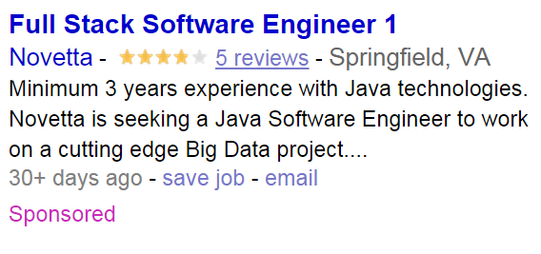
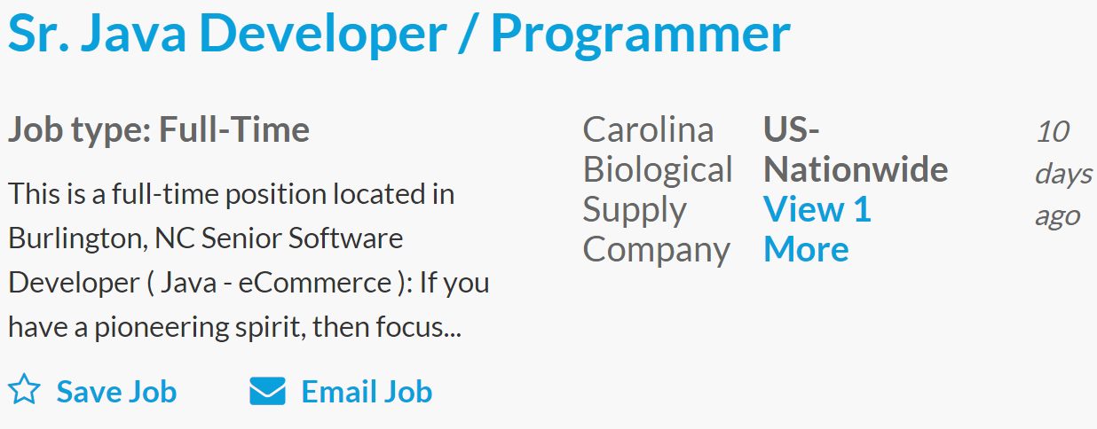
Find a Uniform Structure for Job Data
Job data layout differs on these websites
Uniform structure used:
Job title
Employer
Summary
Location
Date
URL

Slide 6
Possible Methods for Scraping Job Data
Public API
Python: selenium + PhantomJS + BeautifulSoup
Python: urllib2 + BeautifulSoup

Slide 7
Get Job Data using API
Pros:
Results returned in a well-defined format (JSON or XML)
API calls easy to construct
Sample API call: http://api.indeed.com/ads/apisearch?publisher=APIkey&q=java&l=austin%2C+tx&sort=&radius=&st=&jt=&start=&limit=&fromage=&filter=&latlong=1&co=us&chnl=&userip=1.2.3.4&useragent=Mozilla/%2F4.0%28Firefox%29&v=2
Cons:
Not all companies provide them for free
Monster/Linkedin requires a “partnership”

Slide 8



Selenium + PhantomJS + BeautifulSoup
Pros:
Allows sophisticated operations on the web page
Web form submission
Page navigation
Good for websites with rich Javascript
Cons:
Very slow
Bad for websites with rich AJAX calls
Crashes frequently without good waiting mechanism
Inconsistent results

Slide 9
Urllib2 + BeautifulSoup
Pros:
Works on most websites
Cons:
Have to figure out relationship between url and query
Need to change code whenever website structure changed (HTML)
User-agent check etc.

Slide 10
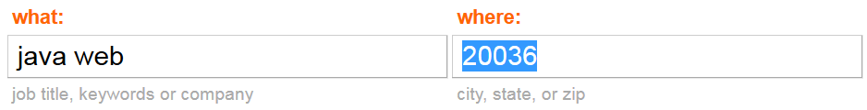

Constructing URL
Sample Indeed.com result url:
http://www.indeed.com/jobs?q=java+web&l=20036&start=20
Plugin in keywords and location, and loop through the result page number (“start” in this case)
Visibility of the “Next” anchor tag is used to determine whether the last page has been reached
Notes:
Indeed gives 100 page, if you give start = 2000, it shows you the 100th page rather than throwing a 404
Not all websites give such good url structure some has encryption and some has search id and stuff

Slide 11
Websites Scraped
Indeed.com
ZipRecriuter.com
SimplyHired.com
Didn’t use some other websites because:
1st page url: http://www.careerbuilder.com/jobseeker/jobs/jobresults.aspx?s_rawwords=java&s_freeloc=22304
2nd page url: http://www.careerbuilder.com/jobseeker/jobs/jobresults.aspx?excrit=freeLoc%3d22304%3bst%3da%3buse%3dALL%3...

Slide 12
Download HTML and extract data with BS
BeautifulSoup has many ways to extract contents from HTML source code
job_divs = soup.find('div',id='job_list').find_all('article')
summary = row.find('span',id=re.compile('NJL_ND__ctl[0-9]+_[a-z]+Teaser')).text.strip()
summary= job_div.find('p', class_ = 'job_snippet').text.strip()
url += job_div.find('a', class_ = 'card-link js-job-link')['href']
Notes:
CSS selector, XPath

Slide 13
Remove duplicates and shuffle the data
Need a unique identifier for each job
Currently employer + title used as id:
Results for ‘Java’ and ‘22304’ shrinks from 302 to 269
The results from different websites returned as lists
Results ordered by ‘relevance’
Results shuffled with Naive Rank

Slide 14
Remaining Questions
Better “unique identifier” for each job
Scrape more websites

